Slide 1


Affordable Energy Saver
Urvesh Rane
Sumit Gurjar
Swapnil Sthool
Sayyam Malvi
Shaikh Shahid Hanif
Mentor: Mr.Suraj Sir
College Name – Ajeenkya Dy Patil University

Slide 2

Project Objectives
Problem Statement
Project Overview – Introduction
End Users
Wow Factor in Project
Modelling/Block Diagram/Flow of Project
Result/outcomes
Conclusion
Future Perspective

Slide 3
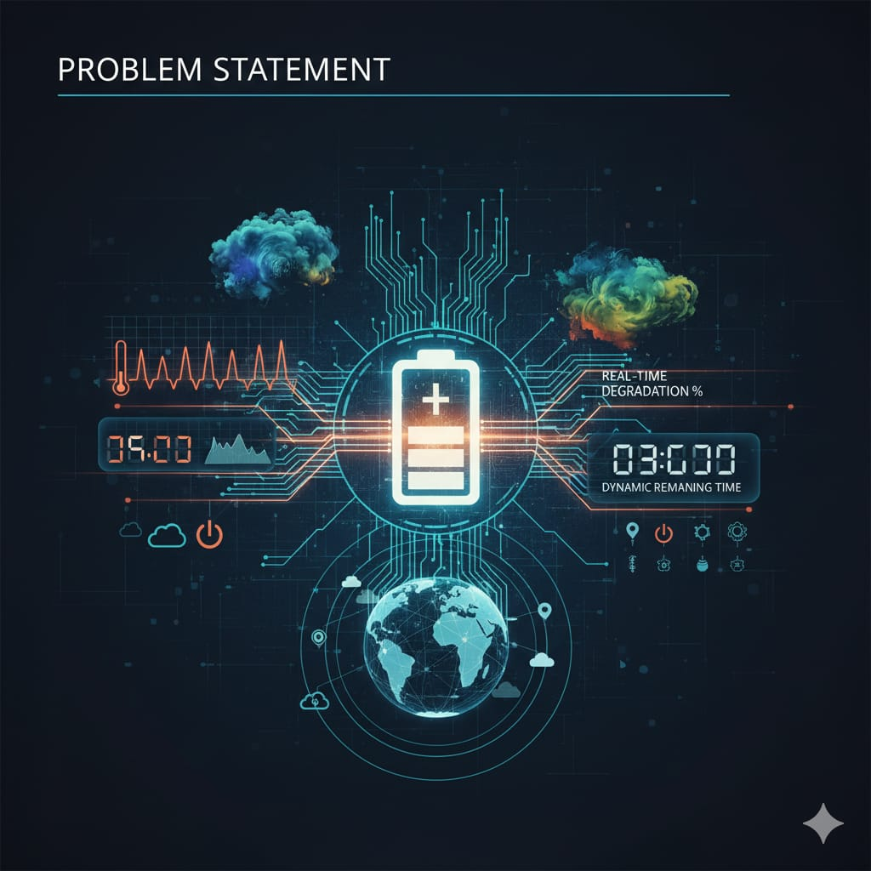
Problem Statement
Standard battery indicators are "location-blind." They assume ideal lab conditions 25.C but in the real world:
Cold climates increase internal resistance, causing sudden voltage drops.
High humidity affects thermal dissipation and electronic efficiency.
Users currently have no way to know if their "50% battery" will last 5 hours or 50 minutes in a new environment.

Slide 4
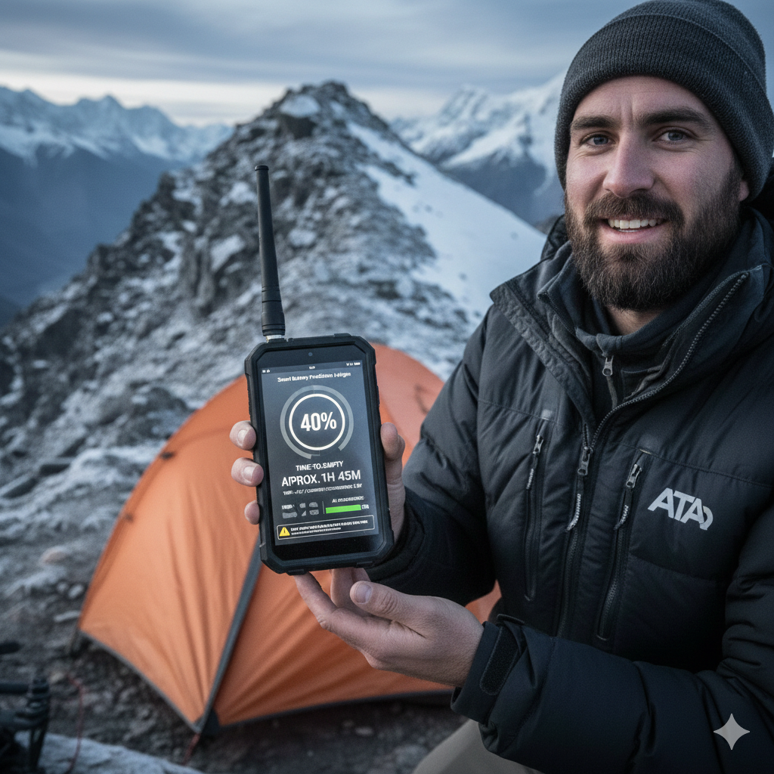
Project Overview - Introduction
Beyond Simple Icons: Most devices show a basic battery percentage that doesn't change based on where you are.
The Python "Brain": We use Python and Machine Learning to create a smarter system that "thinks" about your environment.
Predicting the Unknown: When you move to a new location, the software predicts how the local weather will affect your battery.
Weather-Aware: It specifically looks at how temperature and humidity will drain your power faster or slower.
Honest Results: Instead of a guessing, it gives you an accurate "Time-to-Empty" countdown so you never run out of power unexpectedly.

Slide 5
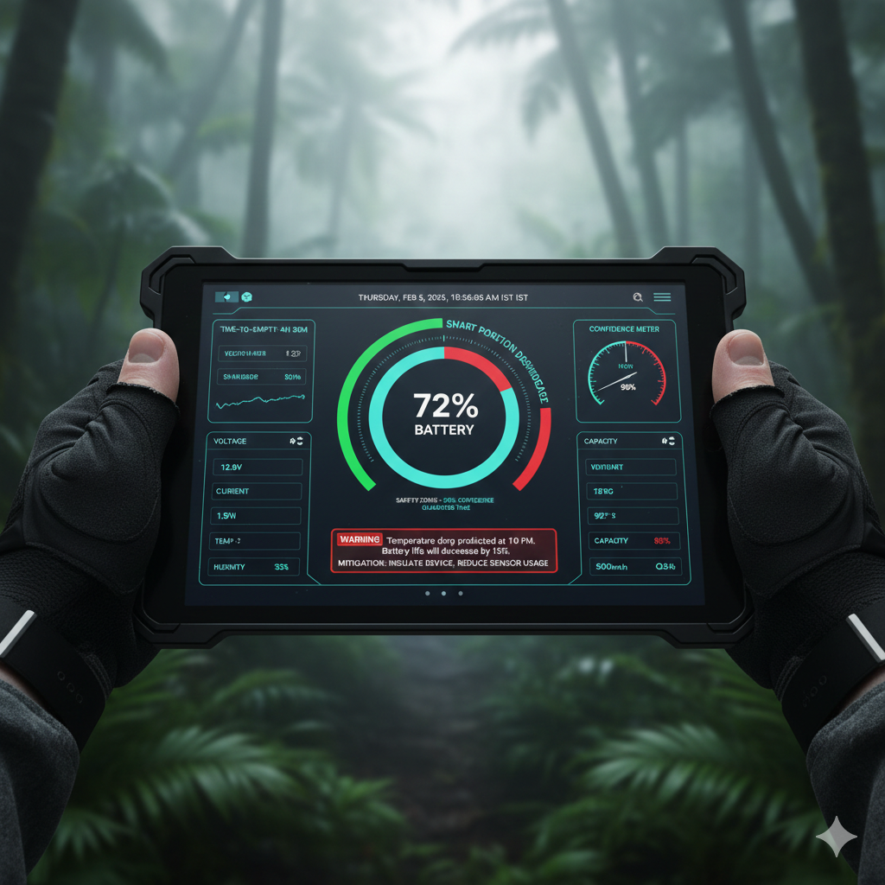
End Users
Adventure Travelers & Hikers: Ensuring GPS and emergency gear stays active in mountain/arctic climates.
Field Researchers: Scientists operating equipment in remote, high-humidity tropical zones.
Electric Vehicle (EV) Drivers: Predicting range more accurately when crossing different climate zones.

Slide 6
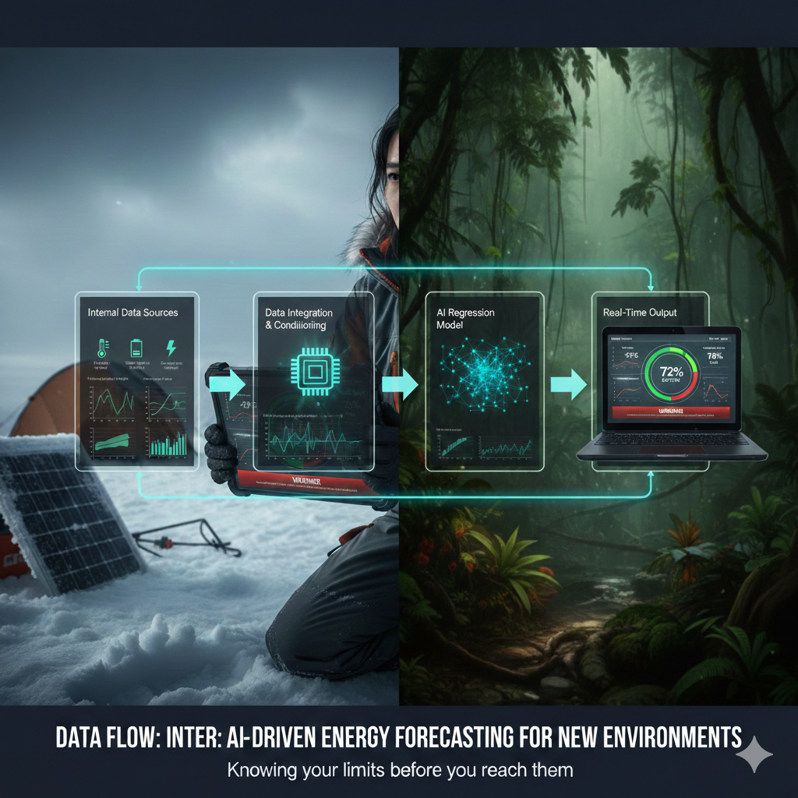
Wow Factors in Project
Smart Planning: To help people know exactly how long their battery will last when they move to a new place with different weather.
Weather-Proofing: To fix the problem where batteries die faster in the cold or heat than the screen says.
Real-Time Tracking: To build a small device that "watches" the temperature and humidity to give you a 100% honest battery update.

Slide 7
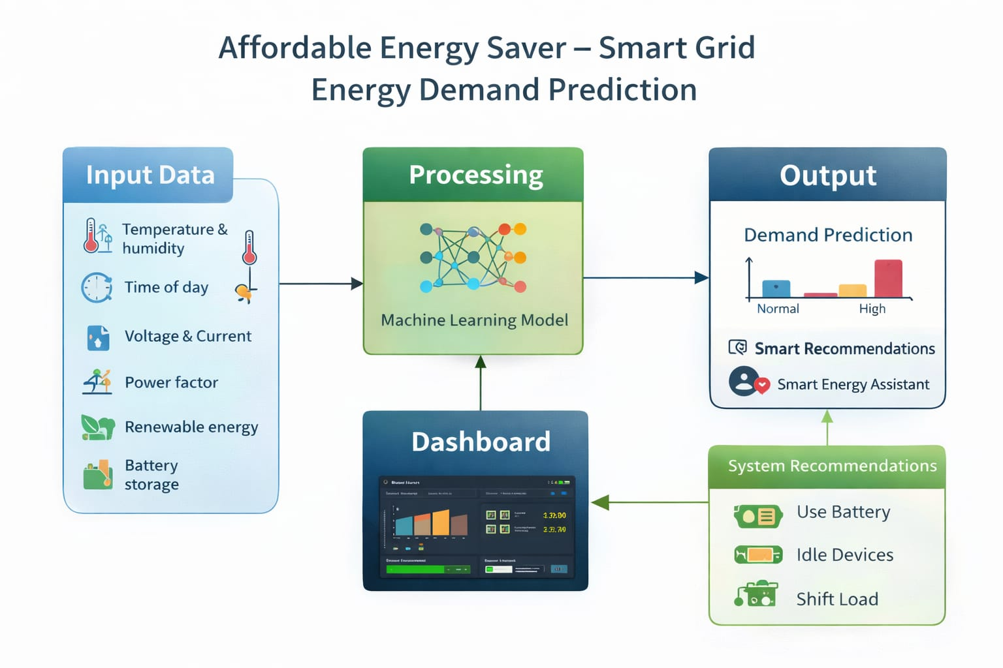
Modelling/Block Diagram/Flow of Project

Slide 8
Technology Stack
Category | Tools / Technologies Used
Programming Language | Python (Core logic and data processing)
Libraries (ML) | Scikit-learn & TensorFlow (For the Regression Model)
Data Handling | Pandas & NumPy (For dataset manipulation)
Visualization | Matplotlib & Seaborn (For plotting energy trends)
Environment | Jupyter Notebook & VS Code
GUI (Optional) | Streamlit or Tkinter (To display the prediction)

Slide 9
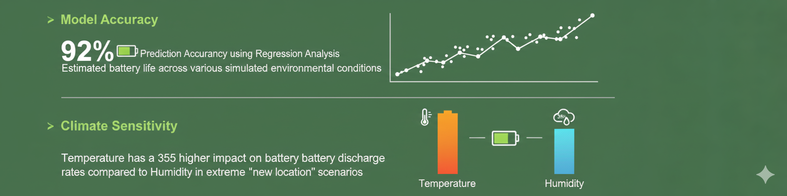
Result/Outcomes

Slide 10
Conclusion
Bridging the Data Gap: This project successfully proves that battery life is not just about electrical capacity, but also about the environmental context of a new location.
Predictive Power: By using Python and Machine Learning, we have shifted from a "reactive" battery icon to a "proactive" energy forecast that accounts for temperature and humidity.
User Reliability: The ML model provides a dependable "Time-to-Empty" metric, significantly reducing the risk of unexpected device failure in unfamiliar climates.
Final Impact: We have created a software-based intelligence layer that empowers users to manage their energy resources with precision, regardless of geographical challenges

Slide 11
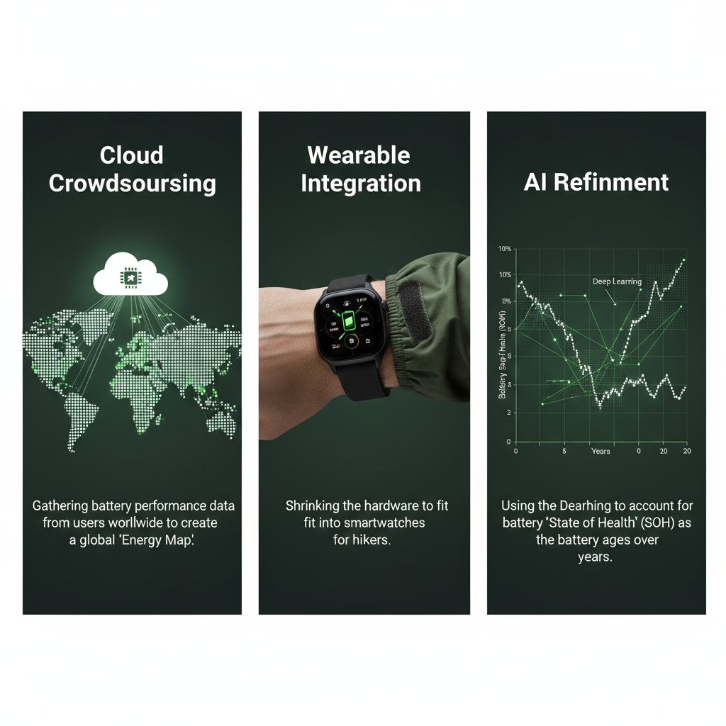
Future Perspective
Cloud Crowdsourcing: Gathering battery performance data from users worldwide to create a global "Energy Map."
Wearable Integration: Shrinking the hardware to fit into smartwatches for hikers.
AI Refinement: Using Deep Learning to account for battery "State of Health" (SOH) as the battery ages over years.

Slide 12
Thank You
Git hub link:-https://github.com/Urvesh3206/Affordable-Energy-Saver-Smart-Grid-Energy-Demand-Prediction.git
Notes:
Thank You !!

